Slide 1
Weekly Meeting
Nov 29, 2021
Gwangwoo Kim

Slide 2
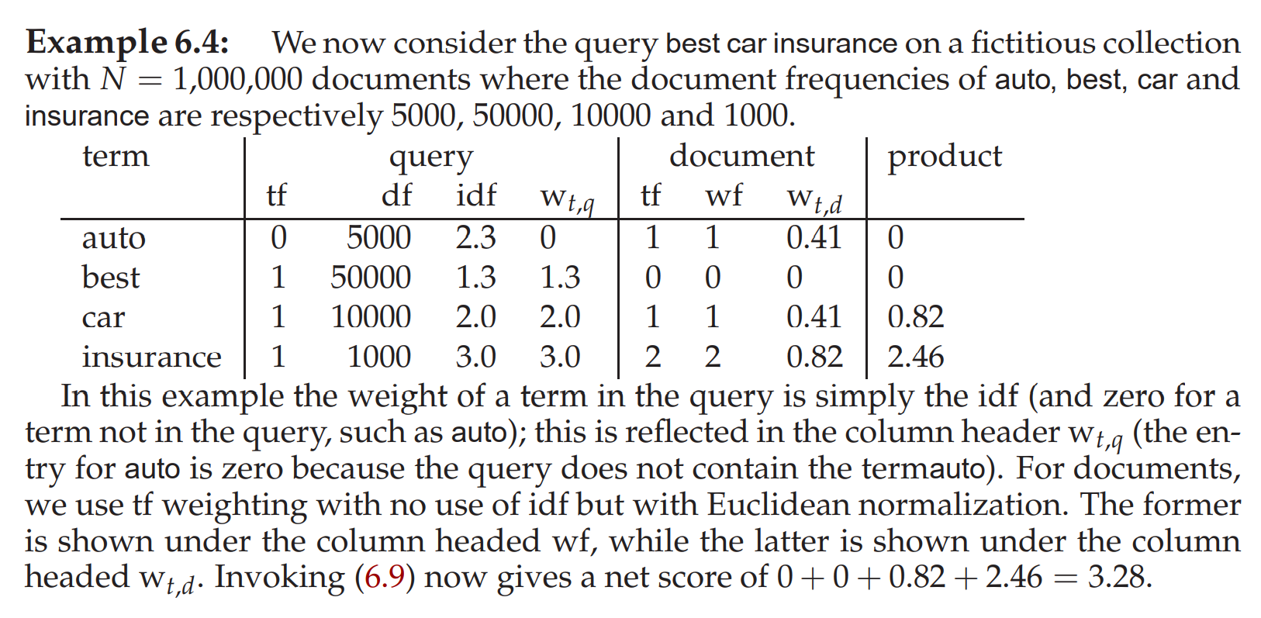
7.1 Efficient scoring and ranking

Slide 3
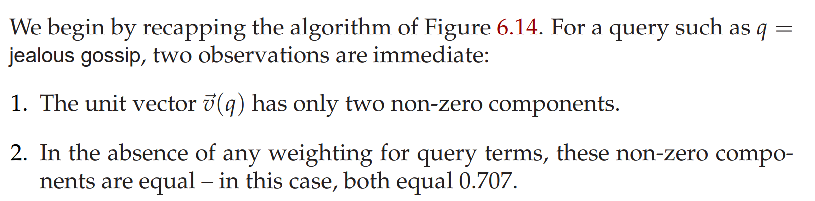
7.1 Efficient scoring and ranking

Slide 4
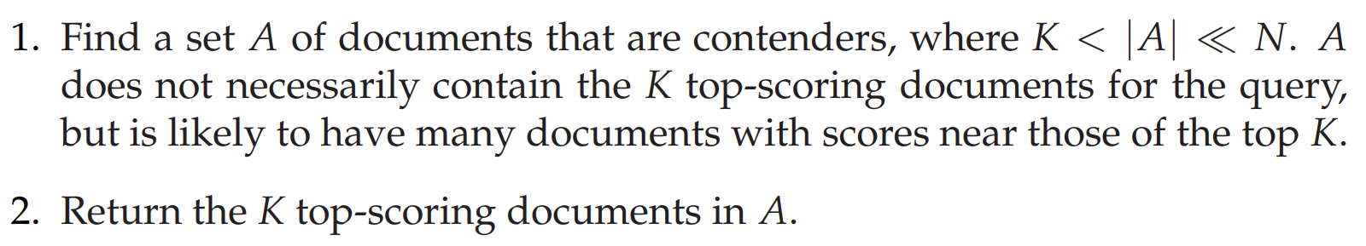
7.1.1 Inexact top K document retrieval

Slide 5
7.1.2 Index elimination
We only consider documents containing terms whose idf exceeds a preset threshold. For instance, on the query “catcher in the rye “, we only traverse the postings for catcher and rye.

Slide 6
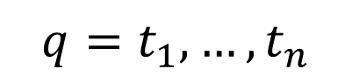
7.1.3 Champion lists
$$q=t_{1},…,t_{n}$$

Slide 7
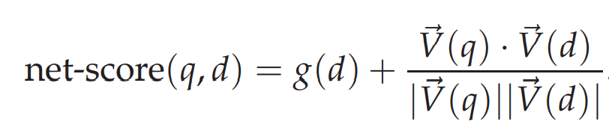
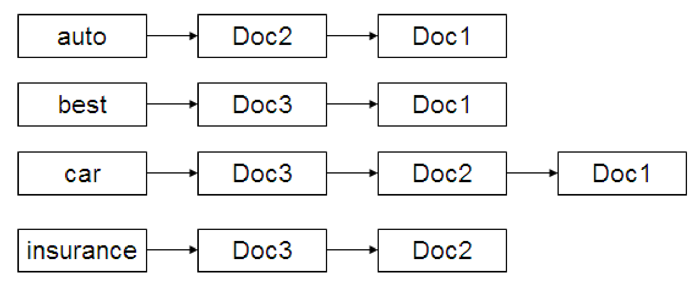
7.1.4 Static quality scores and ordering
We have available a measure of quality g(d) for each document d that is query-independent and thus static.

Slide 8
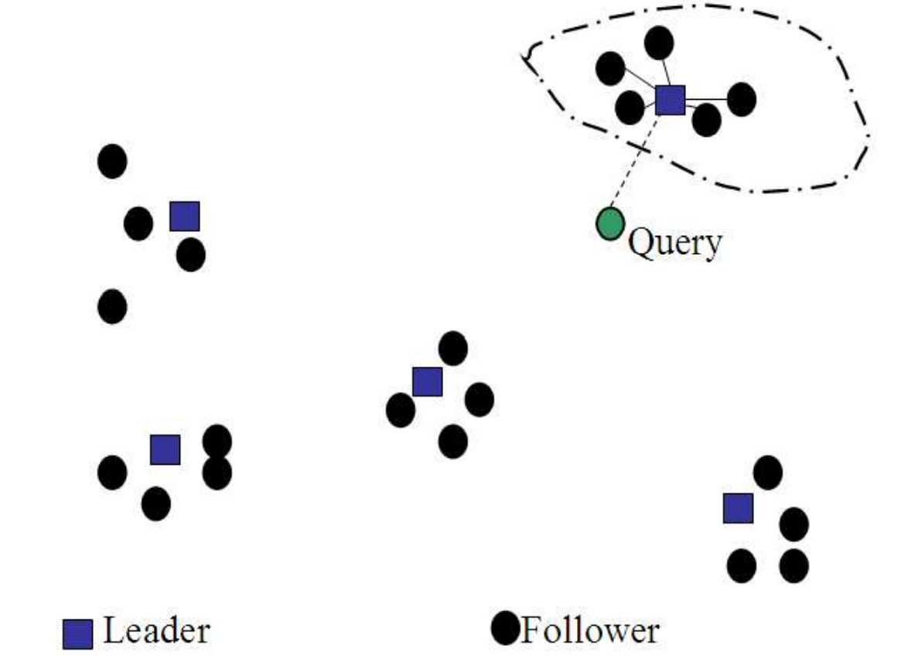
7.1.6 Cluster pruning

Slide 9
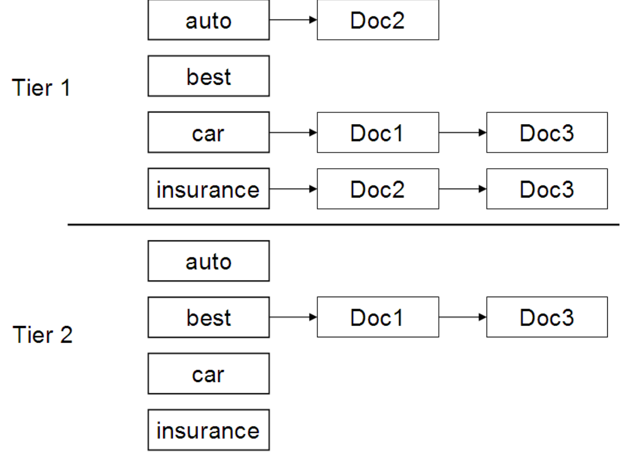
7.2.1 Tiered indexes

Slide 10
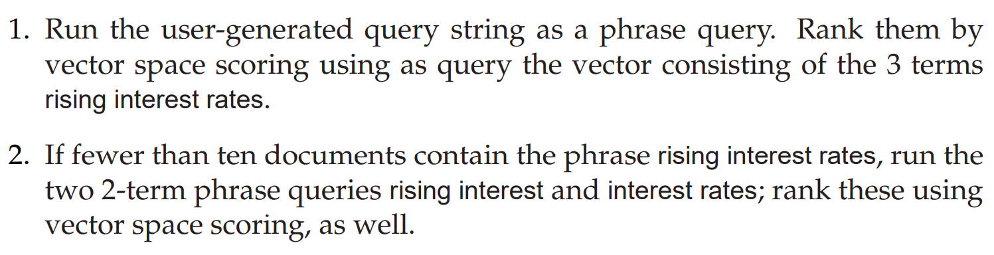
7.2.3 Designing parsing and scoring functions

Slide 11
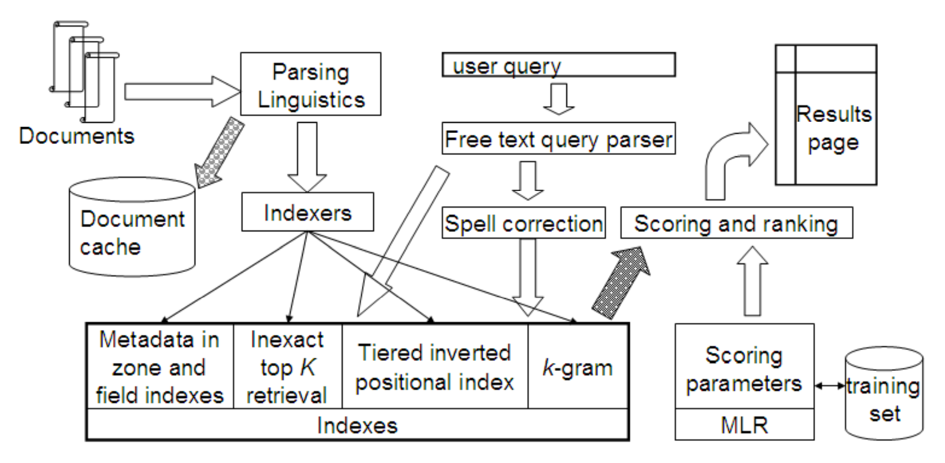
7.2.3 Putting it all together

Slide 12
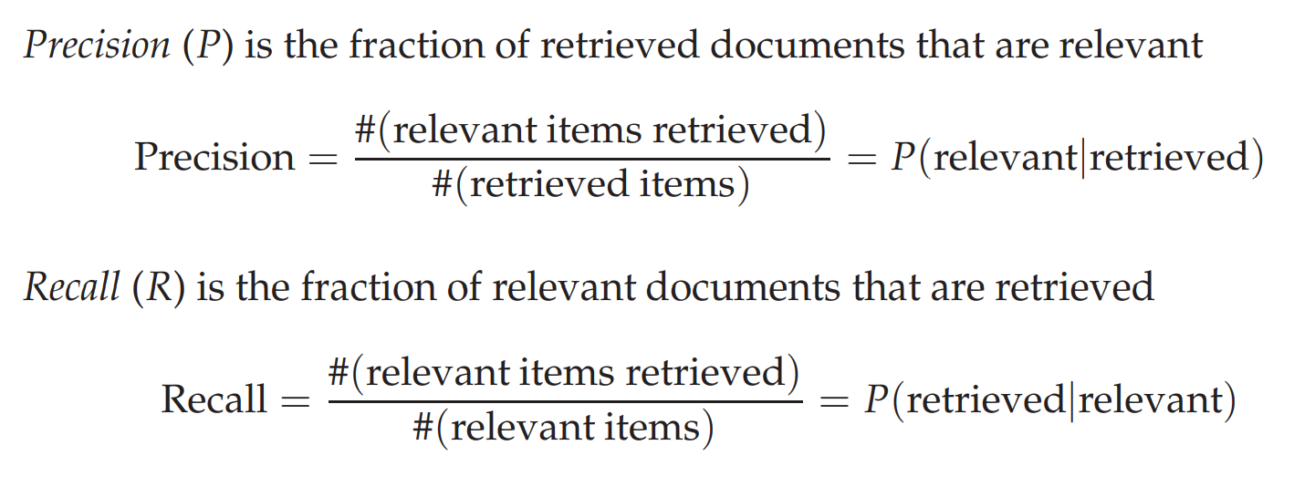
8.3 Evaluation of unranked retrieval sets

Slide 13
8.3 Evaluation of unranked retrieval sets
The advantage of having the two numbers for precision and recall is that one is more important than the other in many circumstances.

Slide 14
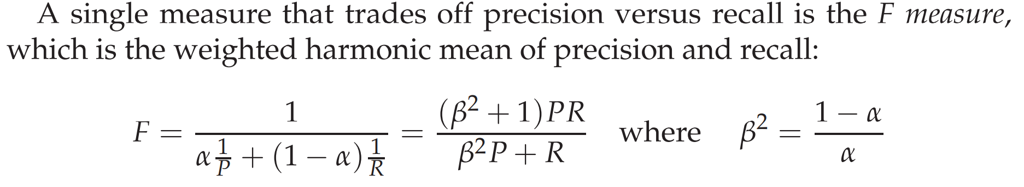
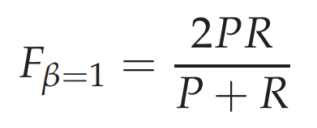
8.3 Evaluation of unranked retrieval sets

Slide 15
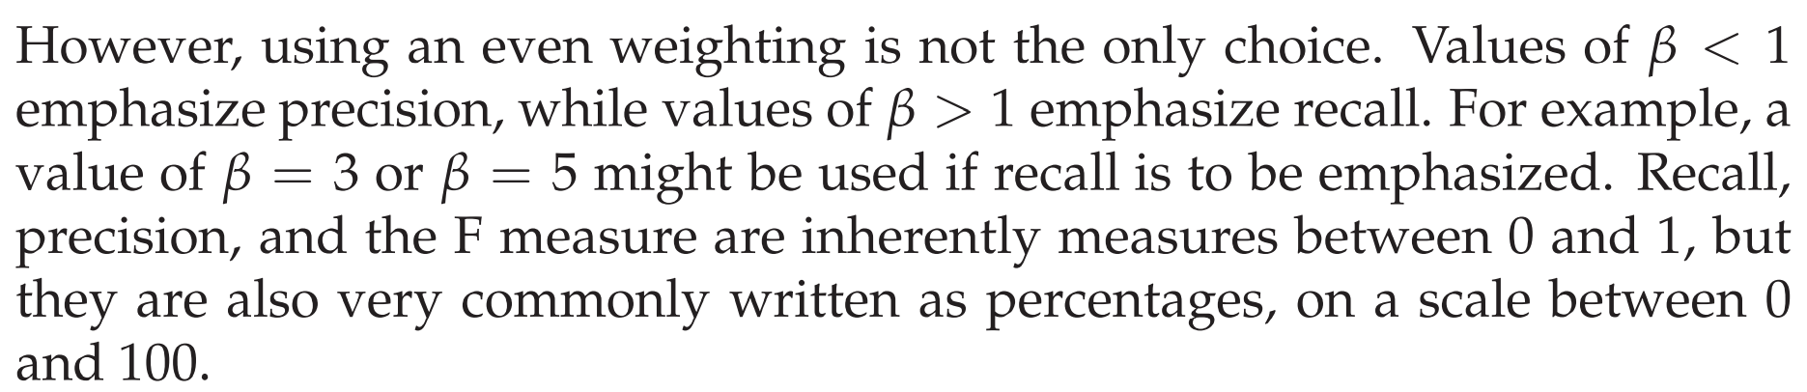
8.3 Evaluation of unranked retrieval sets

Slide 16
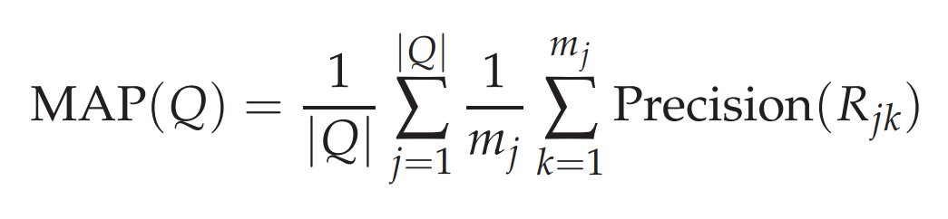
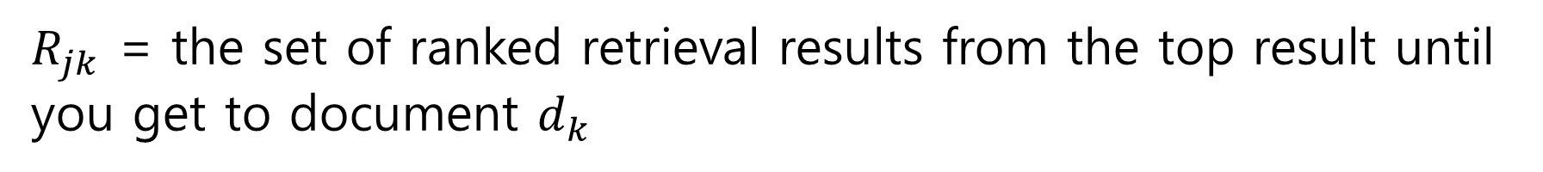
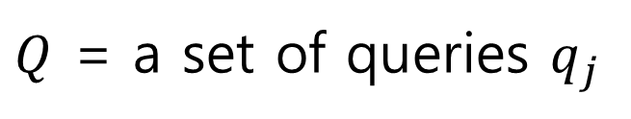
8.4 Evaluation of ranked retrieval results
$Q$ = a set of queries $q_{j}$
$\{d_{1},…,d_{m_{j}}\}$ = the set of relevant documents for a query $q_{j}$
$R_{jk}$ = the set of ranked retrieval results from the top result until you get to document $d_{k}$

Slide 17
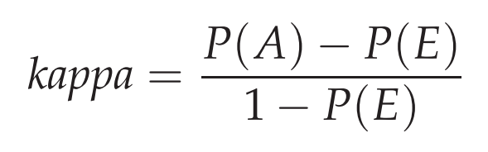
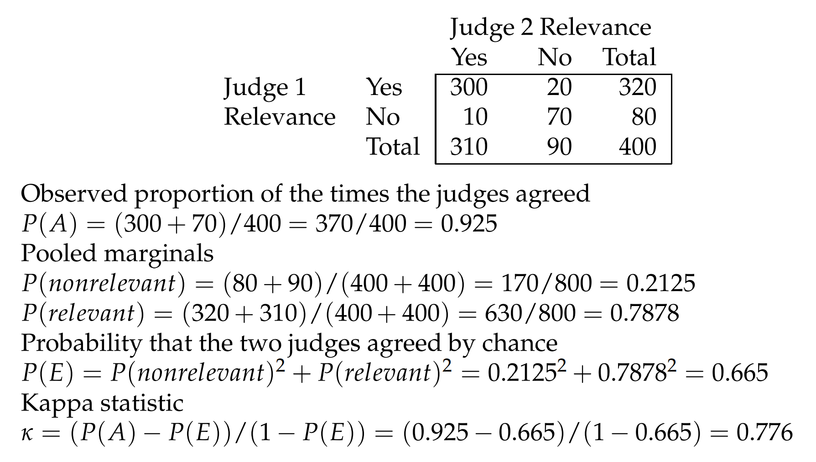
8.5 Assessing relevance
Note: [0.67,0.8]

Slide 18
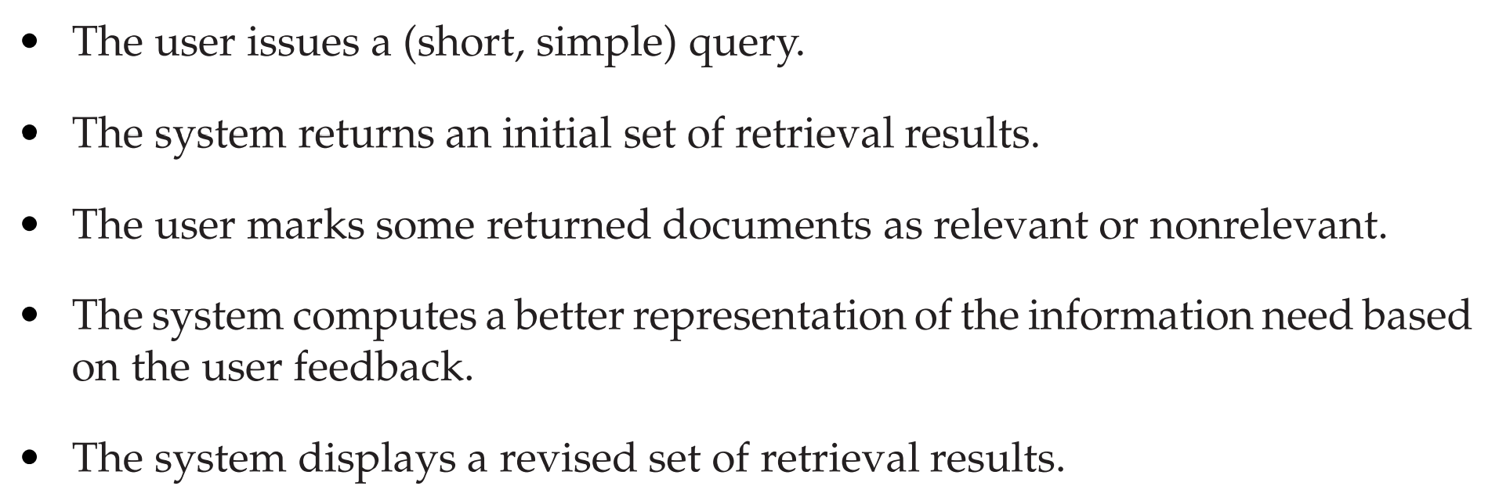
9.1 Relevance feedback and pseudo relevance feedback

Slide 19
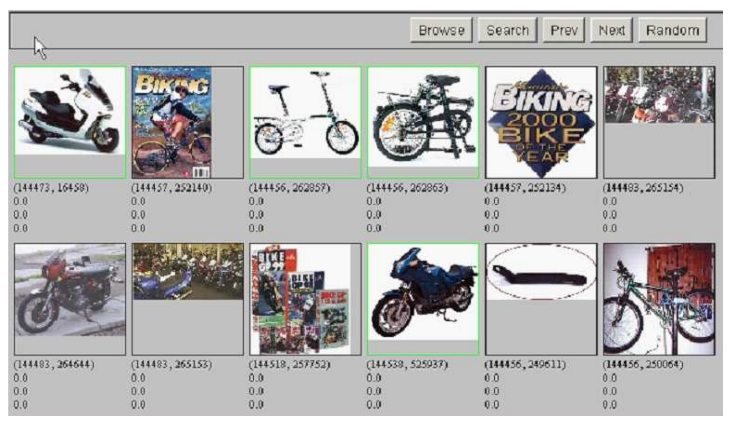
9.1 Relevance feedback and pseudo relevance feedback

Slide 20
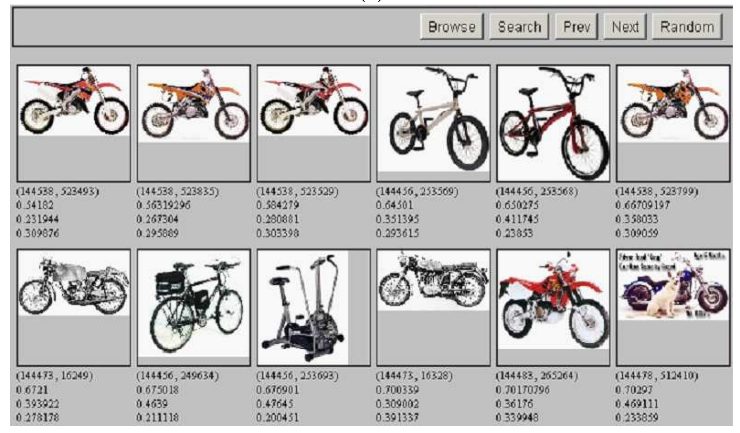
9.1 Relevance feedback and pseudo relevance feedback

Slide 21
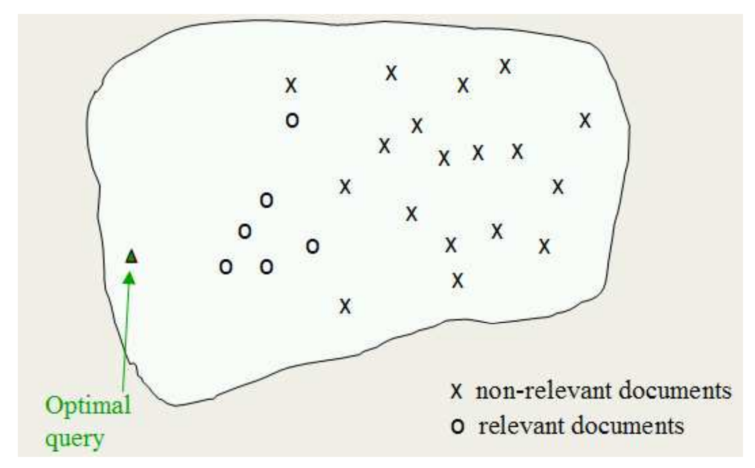
9.1 Relevance feedback and pseudo relevance feedback

Slide 22
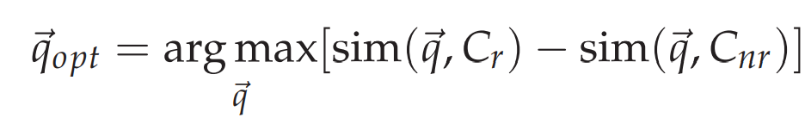
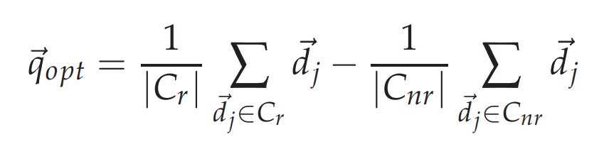
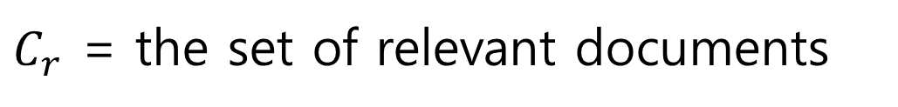
9.1 Relevance feedback and pseudo relevance feedback
$C_{r}$ = the set of relevant documents
$C_{nr}$ = the set of the set of nonrelevant documents

Slide 23
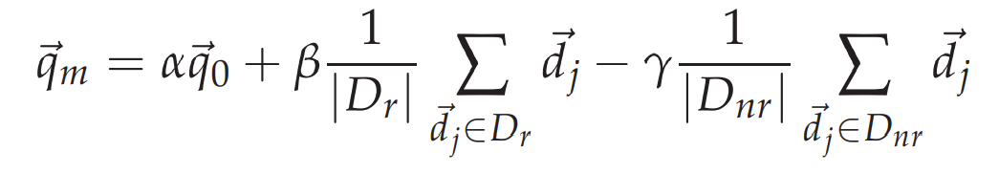
9.1 The Rocchio (1971) algorithm
$C_{r}$ = the set of relevant documents
$C_{nr}$ = the set of the set of nonrelevant documents
Remark: In general, $β$ is more important than $γ$, that is, $γ<β$. Recommended values are 1, 0.75, 0.15 or 0.

Slide 24
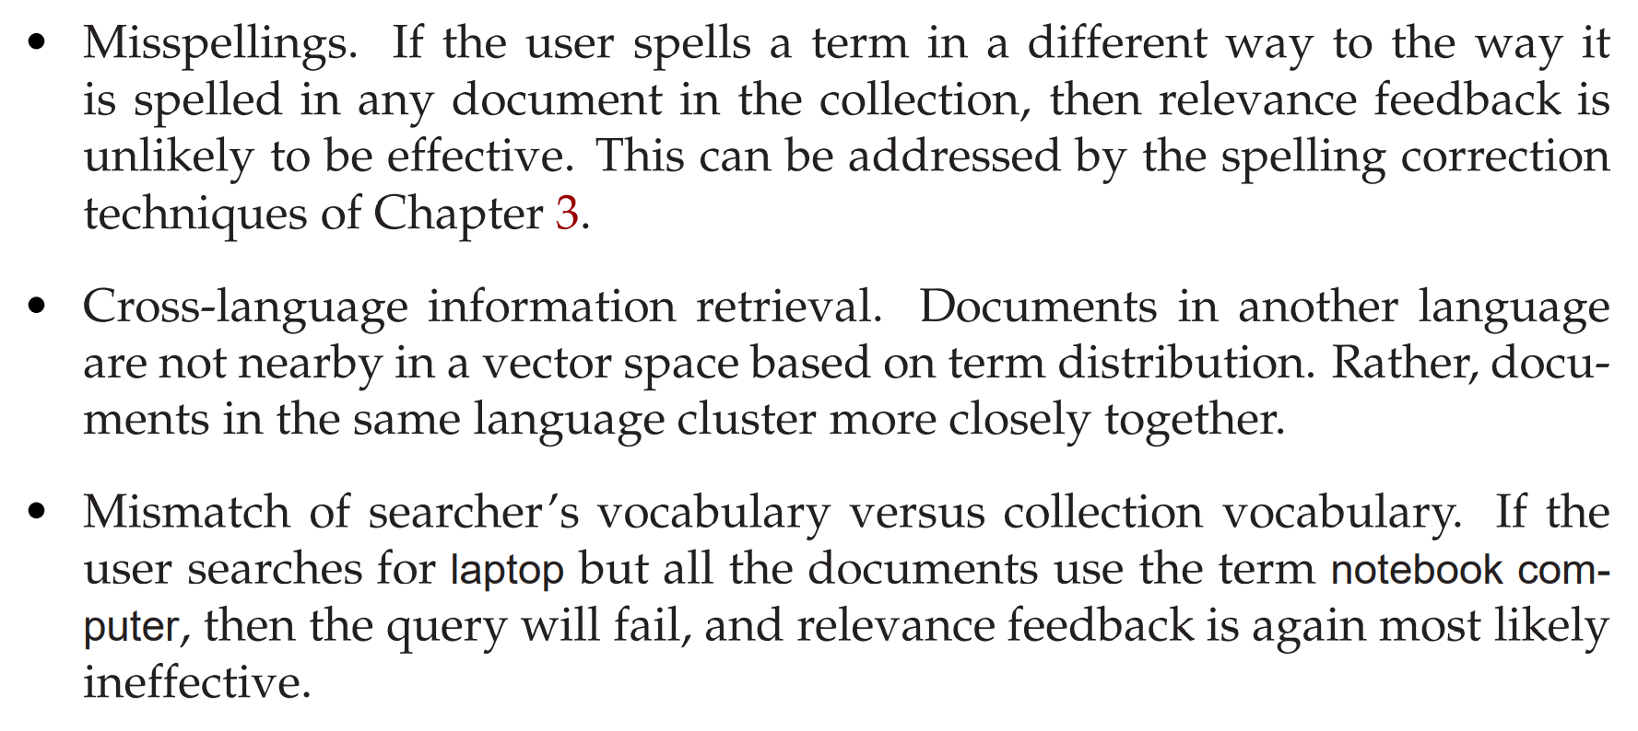
9.1.3 When does relevance feedback work?
1. the user has to have sufficient knowledge to be able to make an initial query.

Slide 25
9.1.3 When does relevance feedback work?
2. the relevance feedback approach requires relevant documents to be similar to each other. That is, they should cluster.

Slide 26
9.1.6 Pseudo relevance feedback
The method is to do normal retrieval to find an initial set of most relevant documents, to then assume that the top k ranked documents are relevant, and finally to do relevance feedback as before under this assumption.

Slide 27
9.1.6 Pseudo relevance feedback
The method is to do normal retrieval to find an initial set of most relevant documents, to then assume that the top k ranked documents are relevant, and finally to do relevance feedback as before under this assumption.

Slide 28
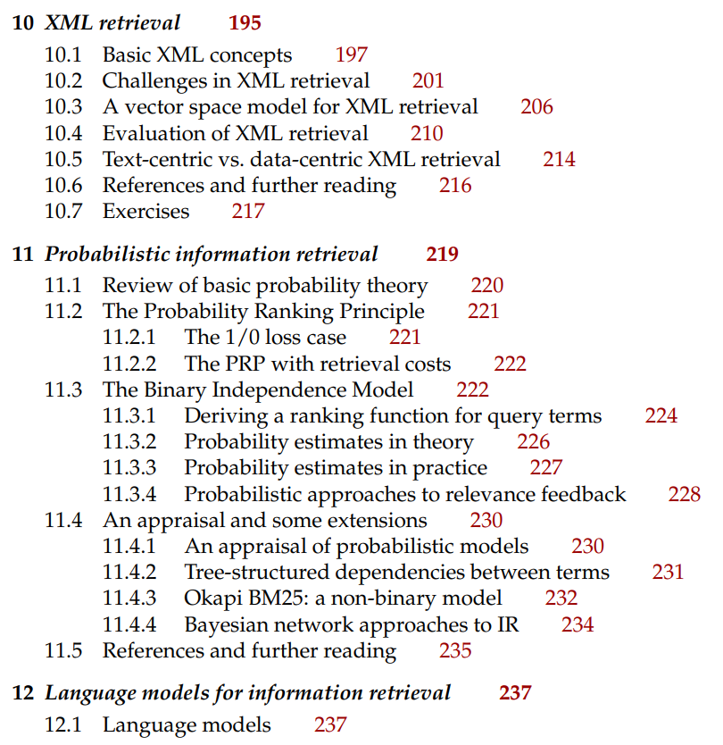
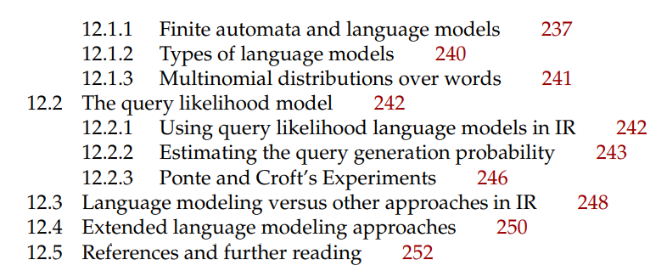
Next Contents

